Slide 1

Scandia Wellness Centre
The Health and Vitality concept

Slide 2
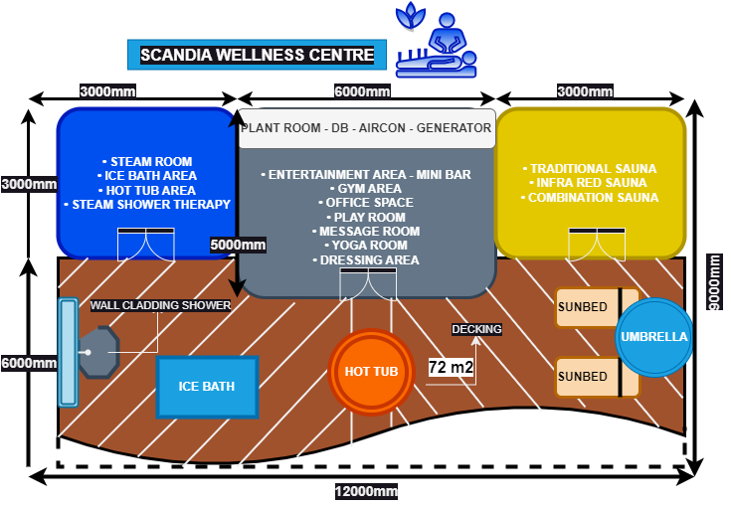
Scandia Wellness Centre dimensions
The layout design can easily be altered to the client specifications & requirements. This is an standard setup of our Scandia Wellness Centre.
We recommend choosing the full scope within the Scandinavian concept to experience the extensive healthy culture it offers.
These dimensions are the comfortable space required to design the centre by adding on all health amenities to fulfil the concept.
The choices of health amenities will determine the final layout space required.
Our Architect and Engineer will redesign new concept layouts should the client require a specific space to allocated the new dimensions in.
The standard setup is 12m x 9m which requires 108m2 of floor plan dimensions.
The Wellness concept does not require building plans as it is an separate freestanding entity.

Slide 3
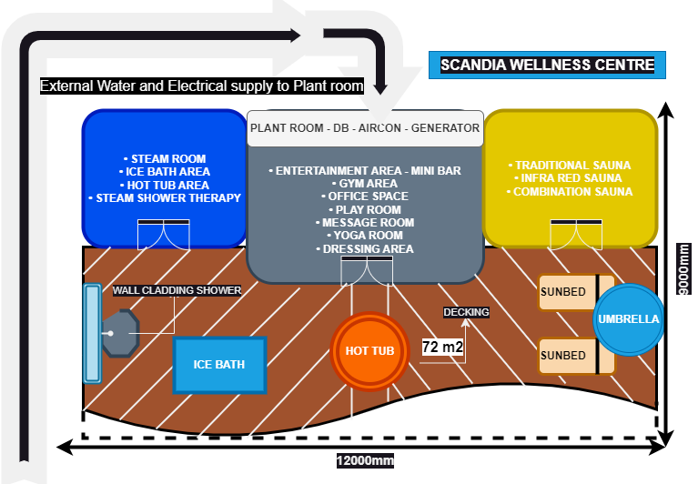
Clients Prerequisite Requirements
The standard setup requirements are based on electricity and water supply to a certain point at the plant room of the Wellness centre supplied by the client.
Single and 3 Phase power supply will determine the size of the health amenities in cubic square meters. The standard size Wellness centre requires 3 Phase power supply.
Propper water pressure supply will be necessary to accommodate the Steam room, shower, hot tub and Ice bath facilities.
If the essential services requires to be incorporated into our foundation, then this can be pre-arranged to be accommodated.

Slide 4
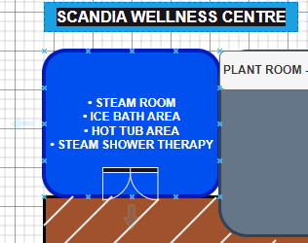
Choice of health amenities – Left building
The combination of health amenities choices on the left building are:
Steam room
Jacuzzi / hot tub
Ice bath
Shower therapy with hydro massage, steam shower and whirlpool.
Should a Steam room be required with an Hot tub and Ice bath, the layout will change.
This can be allocated on the right hand side if required. The two rooms on opposite ends are symmetrical to each other.
Choices of materials will be finalized with site meeting,

Slide 5
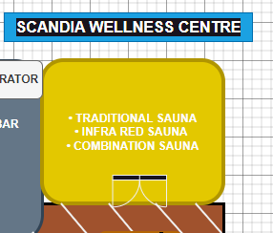
Choice of health amenities – Right building
The combination of health amenities choices on the Right building are:
1) Traditional Sauna Cabin
2) Infra Red Sauna Cabin
3) Combination Sauna Cabin
This can be allocated on the left hand side if required. The two rooms on opposite ends are symmetrical to each other.
Choices of materials will be finalized with site meeting,

Slide 6
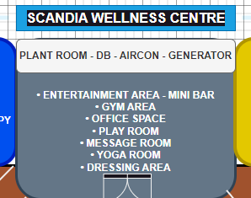
Choice of health amenities - center building
The combination of health amenities choices on the center building are:
• ENTERTAINMENT AREA - MINI BAR
• GYM AREA
• OFFICE SPACE
• PLAY ROOM
• MESSAGE ROOM
• YOGA ROOM
• DRESSING AREA
You may choose which amenities will suit you best for your requirements in the middle section of the Wellness centre.
Choices of materials will be finalized with site meeting,

Slide 7
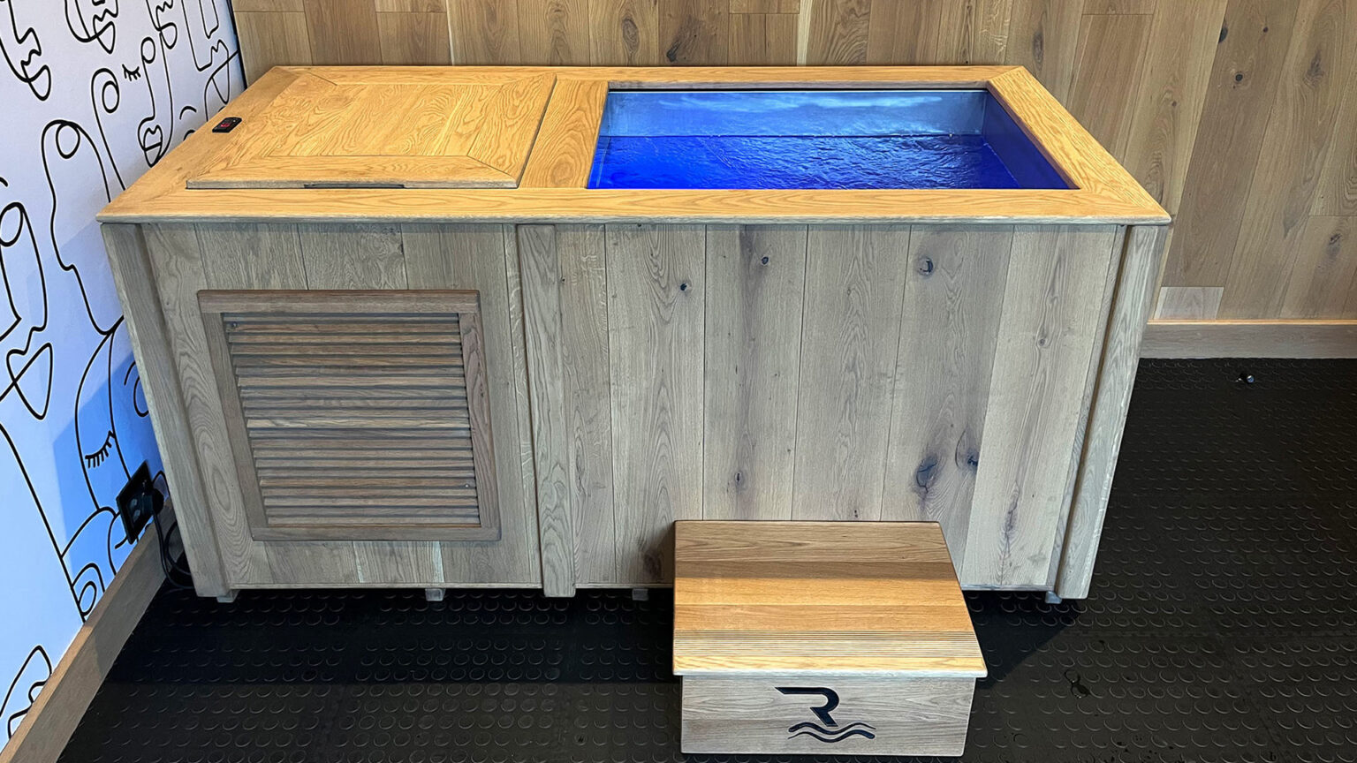
Individual health amenities – Ice Bath
Tub Material: Galvanised Steel Underwater LED Light: No External Dimensions: L2400mm W830mm H750mm
Internal Dimensions: L1400mm W600mm H580mm
Warranty: 1-Year Limited
Lead Time: 4-6 Weeks
50% deposit to secure the order; remaining 50% payable upon completion PRIOR to delivery.
Ready to install, fully automated cleaning system.
Excludes delivery fee. – Cover Optional Extra
ZAR70.000 – ZAR105,000 EX VAT – Delivery exclusive

Slide 8
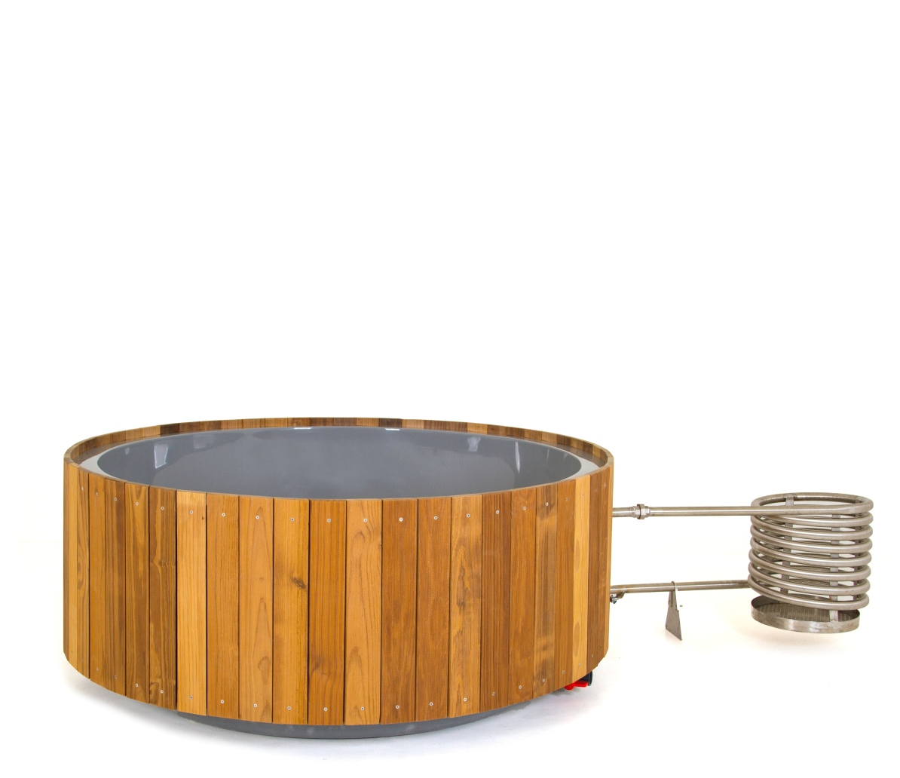
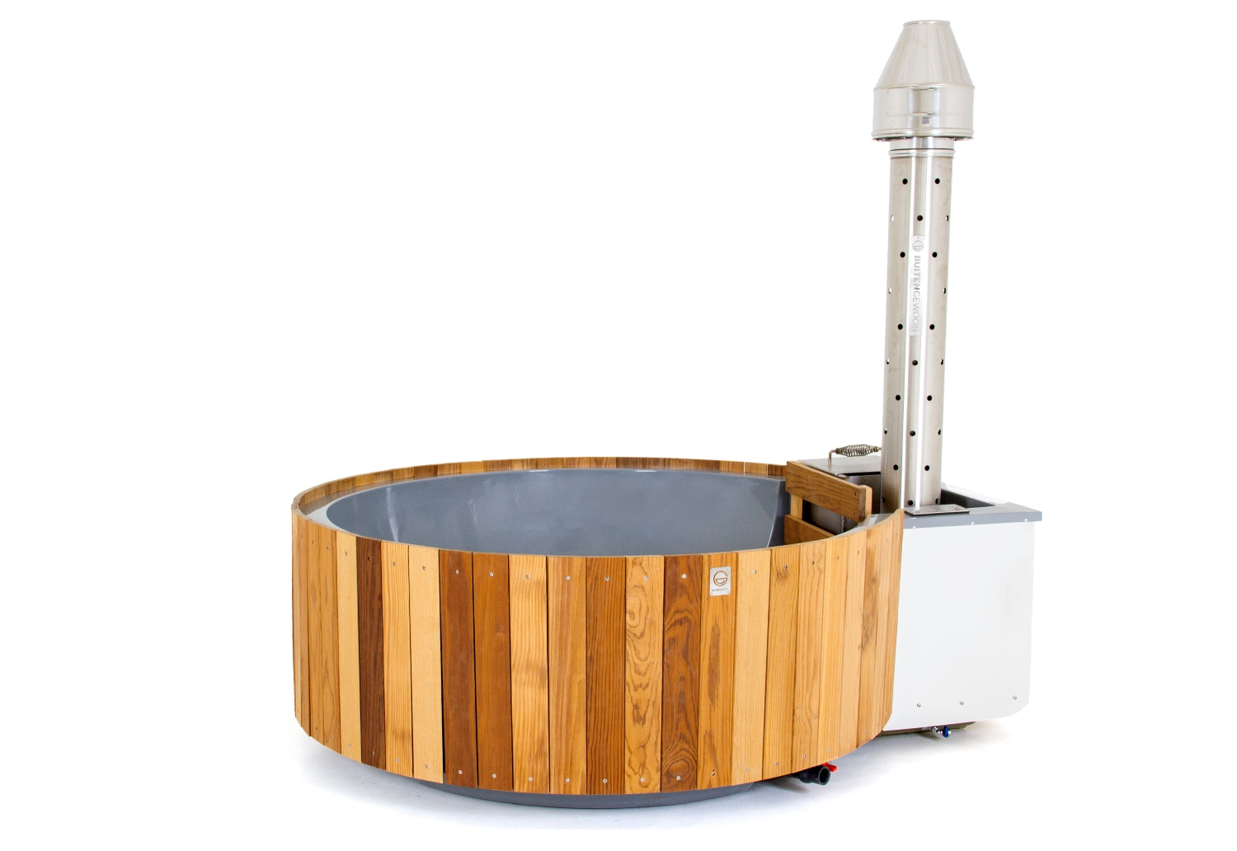
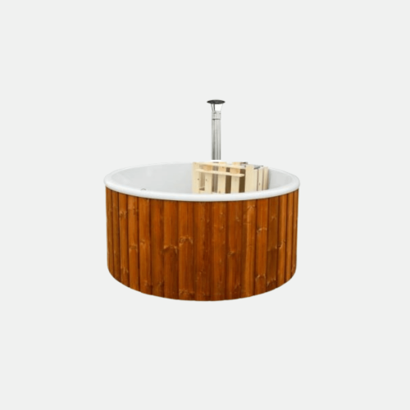
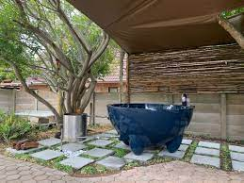
Individual health amenities – Hot Tubs
Experience the soothing crackle of the fire and the embrace of naturally heated water, offering the ultimate relaxation experience. The hot tub operates on the timeless principle of natural convection heating. Simply ignite a wood fire in the heating coil or submerged snorkel stove, and watch as the warmth effortlessly circulates into the tub, all without the need for electricity.“
1) Wood-fired Hot Tub with coil heater
R41 082.60 – Ex. VAT - Exclude delivery
2) Wood-fired Hot Tub with snorkel heater
58 430.45 – Ex. VAT - Exclude delivery
3) Wood-fired Hot tub with 6 jets
ZAR 35 056.55 Ex. VAT - Exclude delivery
4) Tickle Hot Tub
ZAR 26 200.00 Ex. VAT - Exclude delivery
Lead times from 4 – 6 weeks – Optional Extras available – Enquire within

Slide 9
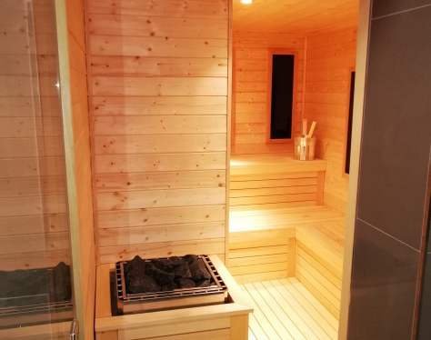
Sauna Cabins – Traditional & Infra Red
Choice between a Traditional & Infra red or a combination of both Sauna Cabin.
The Traditional Sauna cabin provides a hot rock experience through heating up the cabin, sweating and can reach temperatures of up to 110 degrees. The experience is from outside to inside the body.
The infra red Sauna provides IR panels that penetrate your skin 3 times more with electromagnetic waves and the experience is from inside to outside. The room temperature can reach up to 40 -60 degrees depending of the amount of panels installed.
Digital control panel optional. Custom build cabins – Prices ranges - Enquire within.

Slide 10
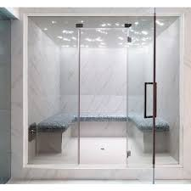
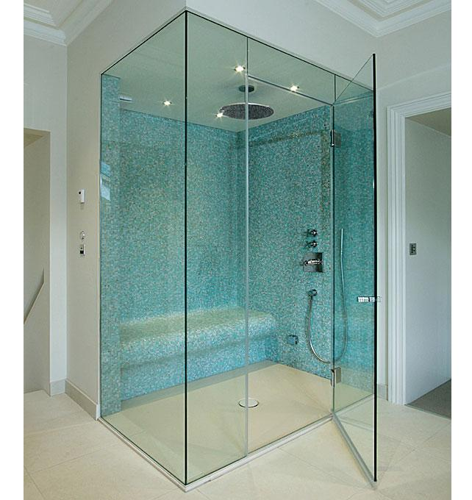
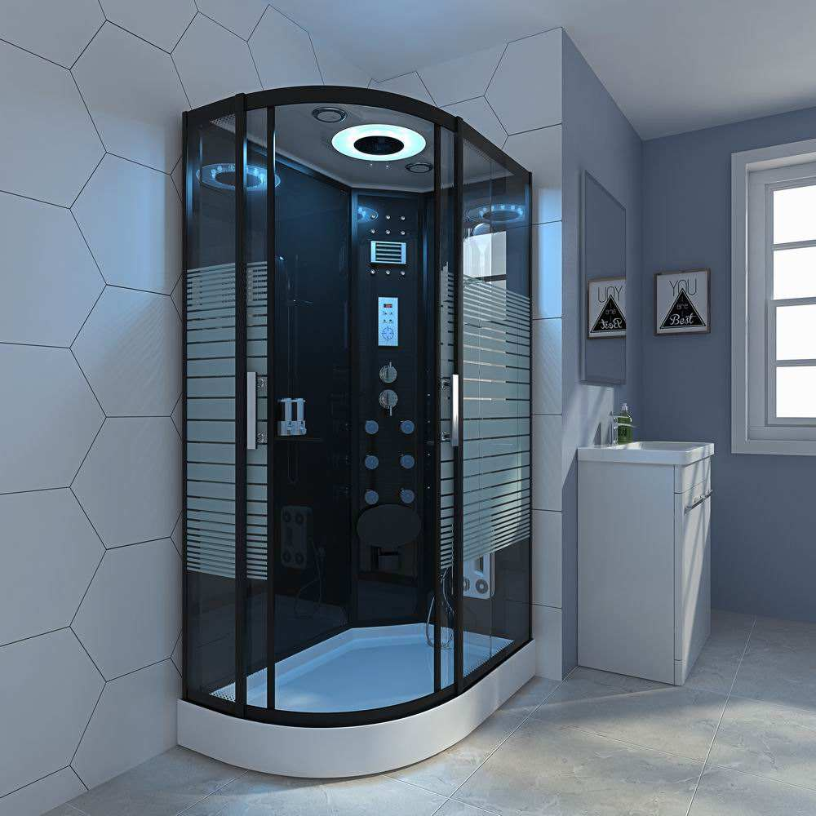
Steam room, Shower or Therapy cabin
Choice between a Steam room, Steam Shower or a Hydro message steam shower with a whirlpool.
The Steam room is like a tropical paradise. It’s a cozy enclosed space, that releases water vapor into the air and creates a hot, humid, and oh-so-invigorating atmosphere,
The ambient temperature in a Steam room can go up to 60 degrees. All Steam room comes with a digital control panels, requires a plant room outside the Steam room or in a protected area not further than 10m.
Custom build Steam units can vary in prices.
Enquire within.

Slide 11
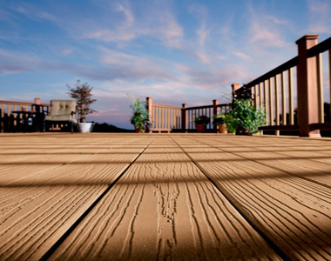
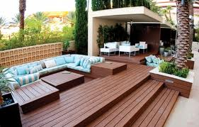
Composite or Natural decking
The choice between natural or composite decking is a preference where natural decking has its own vibrant aesthetic looks, has a unique distinction with its natural grains, knots and will eventually fade and turn into a beautiful grey colour with age.
Where composite decking comes in 2 forms, one a even tone colour in a variety of choices and two with an extrusion capping on given the surface a more natural woodgrain look and protect the surface for a longer time period. Both has different lifespan warrantees. The decking can also be done in a steel or timber sub structure.

Slide 12
Experience the true Scandinavian culture
Contact: Gerhard 082 949 5894

